Slide 1
ADMINISTRATIVE SCIENCE or CLASSICAL MANAGEMENT

Slide 2
HENRY FAYOL (ADMINISTRATIVE SCIENCE)
FRENCH MINING ENGINEER
WITNESSED THE INDUSTRIAL REVOLUTION
SAW A NEED FOR MANAGEMENT THEORY AND TRAINING

Slide 3
6 ACTIVITIES OF INDUSTRY
Technical
Commercial
Financial
Security
Accounting
Managerial

Slide 4
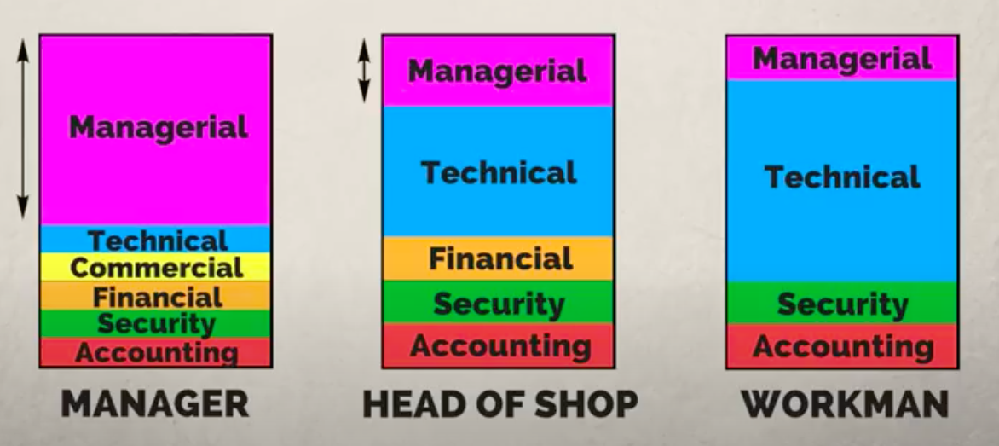
ACTIVITIES OF INDUSTRY

Slide 5
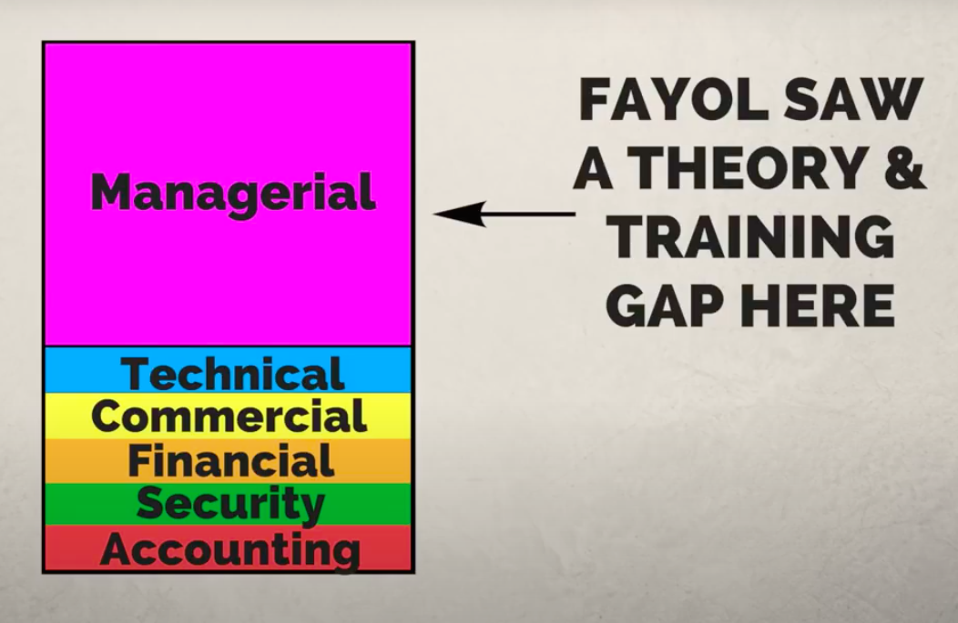

Slide 6
MANAGEMENT ACTIVITIES
Planning
Organizing
Command
Coordination
Control

Slide 7
PRINCIPLES OF MANAGEMENT (DAD U C USSR ----- O I SEE)
Division Of Work
Authority And Responsibility
Discipline
Unity Of Command
Centralization and Decentralization
Unity Of Directions
Scalar Chain

Slide 8
PRINCIPLES OF MANAGEMENT
Stability Of Tenure
Remuneration
Order
Initiative
Subordination Of Individual Interest To General Interest
Equity
Esprit De Corps

Slide 9
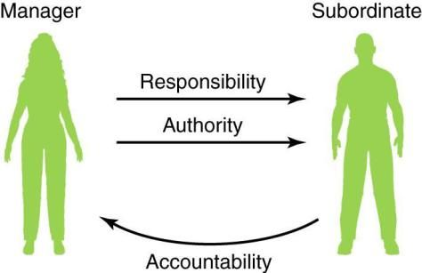
A & R

Slide 10

Unity of Command

Slide 11

Unity of Direction

Slide 12
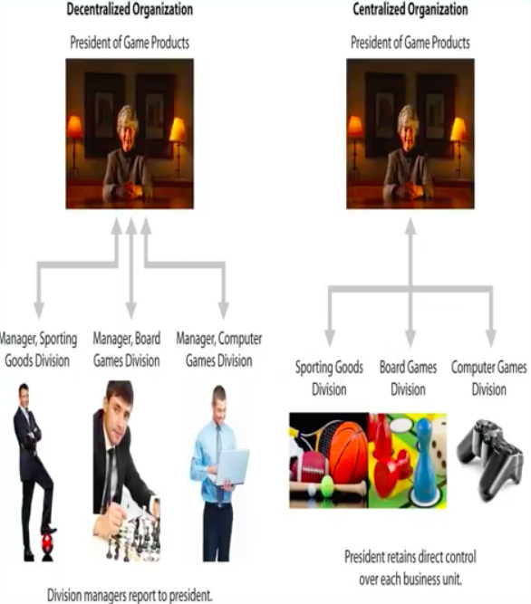
CENTRALIZATION AND DECENTRALIZATION

Slide 13
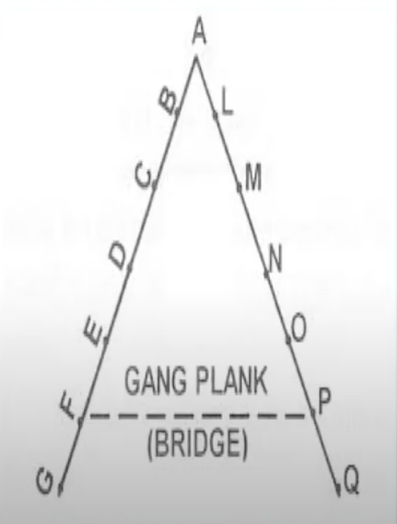
SCALAR CHAIN

Slide 14
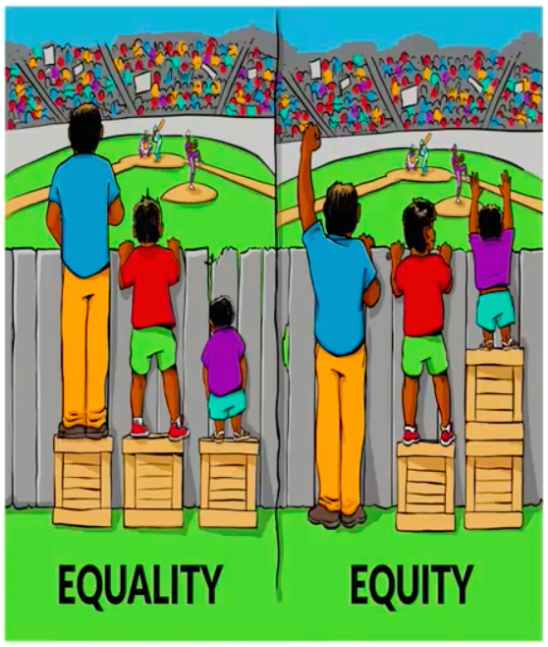
EQUITY

Slide 15

Remuneration

Slide 16

Initiative

Slide 17

Subordination Of Individual Interest To General Interest

Slide 18

Stability Of Tenure

Slide 19

Esprit De Corps

